Slide 1

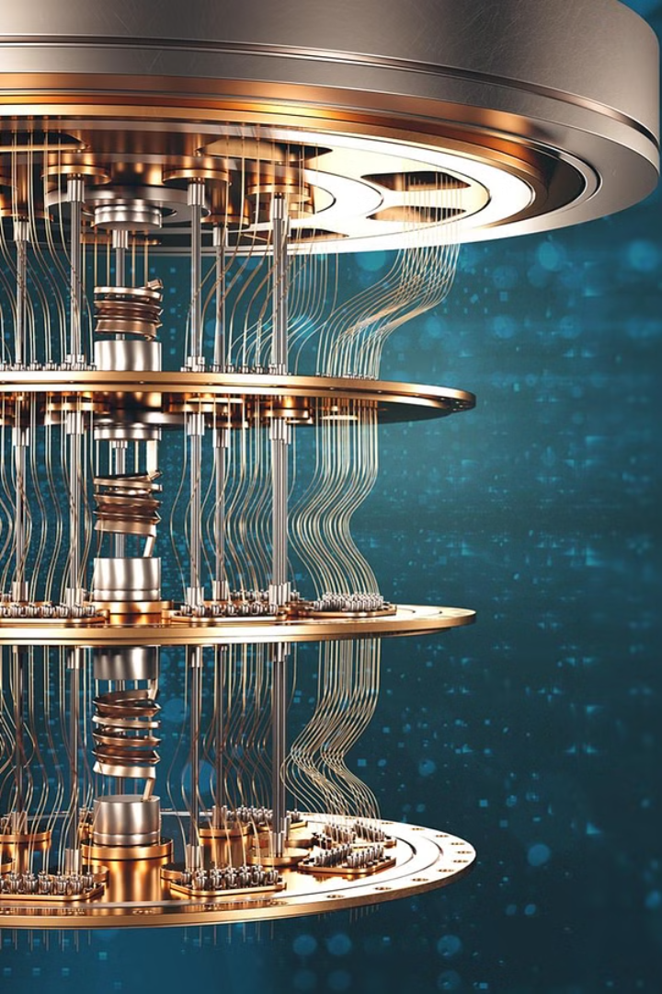
From Bit to Qubit :Quantum Computing as The Future of Technology
Quantum computing represents the next frontier in technology, harnessing the unique properties of quantum mechanics to revolutionize data processing and problem-solving. This cutting-edge field promises to unlock unprecedented computational power, ushering in a new era of scientific breakthroughs and technological advancements.

Slide 2
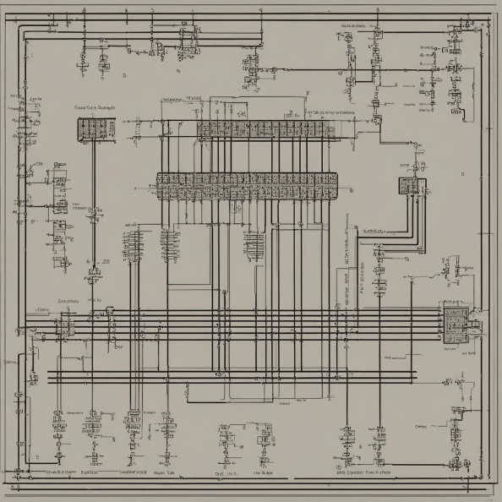
How Classical Computing Works
Classical computing operates using bits, which can be either 0 or 1.
Through the manipulation of these bits, classical computers perform operations and store data using binary logic.
Algorithms are executed step by step, making classical computing sequential and deterministic.

Slide 3

Quantum Computing
Quantum Concepts
Complex Calculations
Quantum computing is based on quantum phenomena like superposition and entanglement.
It leverages quantum bits or qubits to perform complex calculations at exceptional speed.
Exponential Power
Quantum computing offers exponential processing power for tackling scientific and computational challenges.

Slide 4
History of Quantum Computing
1
Richard Feynman's Proposal
In 1981, Richard Feynman proposed the concept of quantum computing in a keynote speech at MIT.
2
The first experiment
In 1994, Isaac Chuang and his team at the Los Alamos National Laboratory conduced demonstration of quantum algorithm
3
Shor's Algorithm and Encryption
Shor's algorithm raised the possibility of breaking RSA encryption, sparking interest in quantum-resistant cryptography.
4
First quantum computer
In 2001, John Martinis and his team at the University of California, Santa Barbara, built the first quantum computer using superconducting qubits
5
Commercial Q
In 2011, The first commercially available quantum computer was offered by D-Wave Systems
6
Recent advancement
2023: Researchers entangled two ions over a distance of 230 meters, and Alpine Quantum Technologies demonstrated a quantum volume of 128 on its quantum computer system PINE

Slide 5
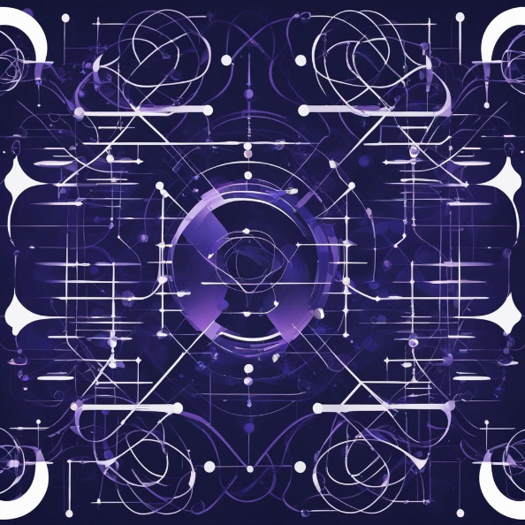

Introduction to Quantum Mechanics
Quantum mechanics is a fundamental theory in physics that describes the behavior of matter and energy at the atomic and subatomic levels.
What sets it apart from classical mechanics is its reliance on probability instead of certainty, and the concept of superposition.

Slide 6
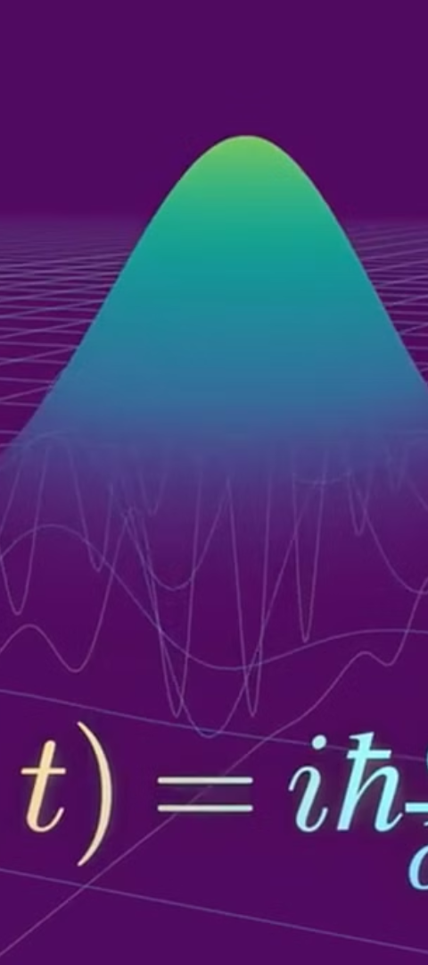
Introduction to Quantum Mechanics
1
Superposition
2
Entanglement
Quantum particles can exist in multiple states simultaneously, a phenomenon known as superposition, which forms the foundation of quantum computing.
Quantum particles can become "entangled," where the state of one particle is inextricably linked to the state of another, even over vast distances.
3
Probabilistic Behavior
Quantum systems exhibit probabilistic behavior, where the outcome of a measurement or observation is not deterministic but rather a distribution of possible states.

Slide 7
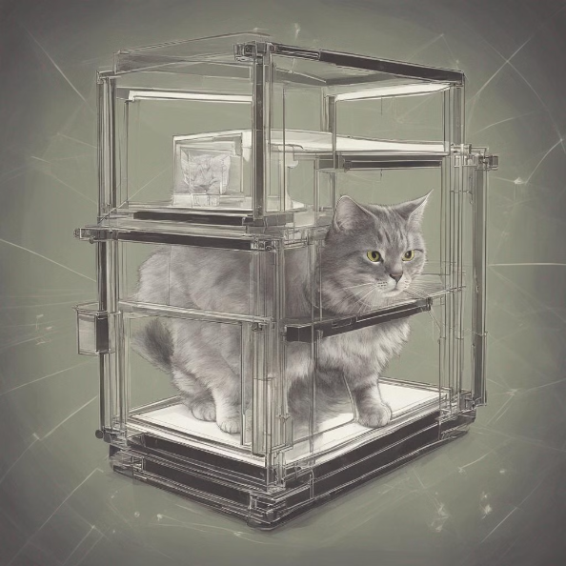
Quantum Superposition: Schrödinger's Cat
Schrödinger's cat is a thought experiment that illustrates quantum superposition.
In the scenario, a cat is theoretically both alive and dead at the same time.
This situation represents the concept of superposition in quantum mechanics.

Slide 8

Quantum Entanglement
Quantum entanglement is like having two coins where their states are linked, no matter how far apart they are. When one coin is flipped and its state is determined, the state of the other coin is simultaneously known, even if it's miles away physicist called this spooky action at distance .

Slide 9
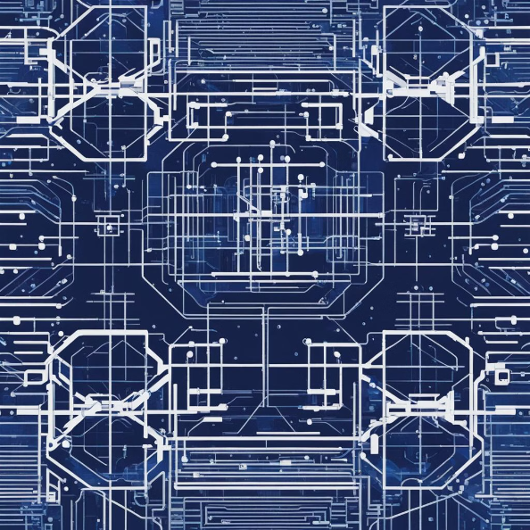
Superposition in Quantum Computing
It's all about parallel processing on steroids.
Regular computer: With multiple bits, a regular computer can explore different possibilities one by one. Like checking each path in a maze.
Quantum computer: With qubits in superposition, a quantum computer can explore all those possibilities simultaneously. Like a ball rolling down all paths in the maze at once!

Slide 10
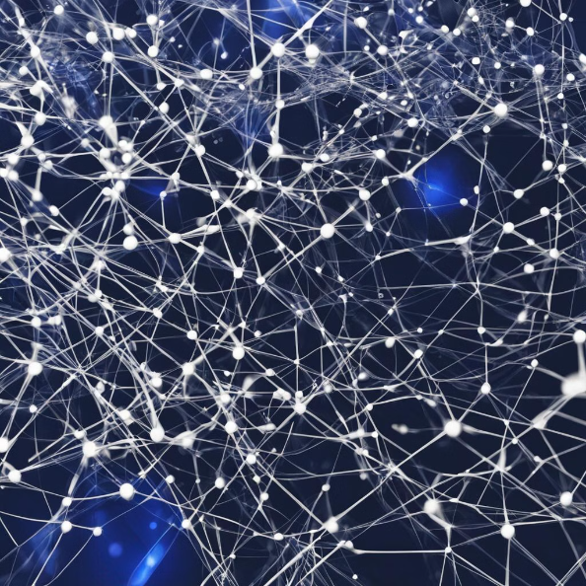
Entanglement in Quantum Computing
Correlated operations: Entanglement allows manipulating multiple qubits with a single operation. When you perform an action on one entangled qubit, its partner instantly reflects the change, even if physically distant. This correlated manipulation is powerful for specific algorithms..

Slide 11
Principles of Quantum Computing
Qubits
Quantum Algorithms
Quantum Gates
The basic unit of information in quantum computing is the qubit, which can represent a 0, a 1, or a superposition of both states simultaneously.
Quantum algorithms leverage the unique properties of quantum mechanics to perform certain computations exponentially faster than classical computers.
Quantum gates are the building blocks of quantum circuits, allowing for the manipulation and transformation of qubits to perform specific computational tasks.

Slide 12

Advantages of Quantum Computing
Speed
1
Quantum computers can solve certain problems, such as factoring large numbers and searching unstructured databases, exponentially faster than classical computers.
2
Efficiency
Quantum computers can operate with a fraction of the energy and resources required by traditional computers, making them more energy-efficient and environmentally friendly.
Cryptography
3
Quantum computers will be able to break many of the encryption methods used today, but they also present opportunities for the development of unbreakable quantum-secure cryptography.

Slide 13

Applications beyond the Hype: Quantum metrology
Quantum metrology, a field that explores the use of quantum technology in precision measurements, holds immense potential in areas such as GPS, navigation systems, and gravitational wave detection.
Utilizing quantum properties to enhance measurement accuracy could revolutionize fields reliant on precise measurements, offering unprecedented levels of precision and reliability in various applications.

Slide 14
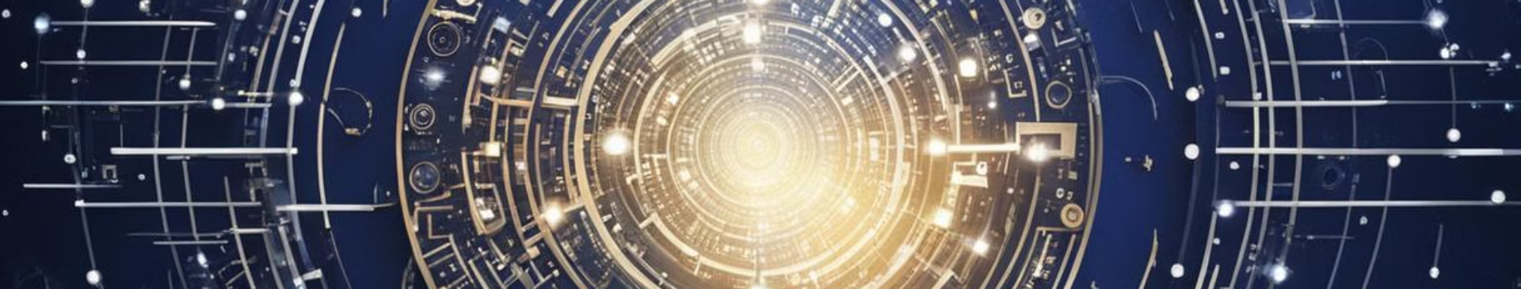
Quantum Internet
Secure Communication
Information Encryption
Unhackable Networks
Quantum internet enables secure communication through quantum key distribution.
Data can be securely transmitted using quantum encryption protocols, ensuring privacy.
Quantum internet creates unhackable networks, safeguarding against cyber threats.

Slide 15
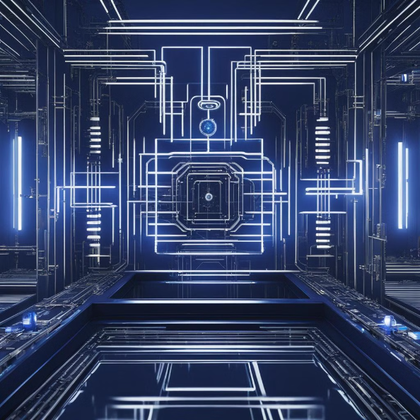
Quantum Simulation
Quantum simulation involves using quantum computers to simulate complex quantum systems.
By leveraging the principles of quantum mechanics, these simulations enable the study of phenomena that are not practical to investigate through traditional computing methods.
Quantum simulation holds the potential to revolutionize scientific research, material discovery, and drug development.

Slide 16
Current Applications of Quantum Computing
Financial Modeling
Quantum Chemistry
Machine Learning
Quantum computers can simulate complex financial models and optimize investment portfolios, leading to more accurate predictions and improved decision-making in the financial sector.
Quantum computers can simulate the behavior of complex molecules and chemical reactions, accelerating drug discovery and the development of new materials.
Quantum algorithms can enhance machine learning models by providing faster data processing, improved pattern recognition, and more efficient training of neural networks.

Slide 17
Current Quantum Computers
IBM Quantum Computers
Rigetti Quantum Computers
Google Quantum Computers
Honeywell Quantum Computers
IBM offers a range of quantum computers such as the IBM Q System One, known for its innovative design and increased performance.
Rigetti Computing provides access to quantum computers and quantum hardware with its Quantum Cloud Services.
Google's quantum computing efforts, including the Bristlecone and Sycamore systems, have made significant strides in quantum supremacy.
Honeywell's quantum computers use trapped-ion technology, offering high-fidelity qubits and efficient error correction.

Slide 18
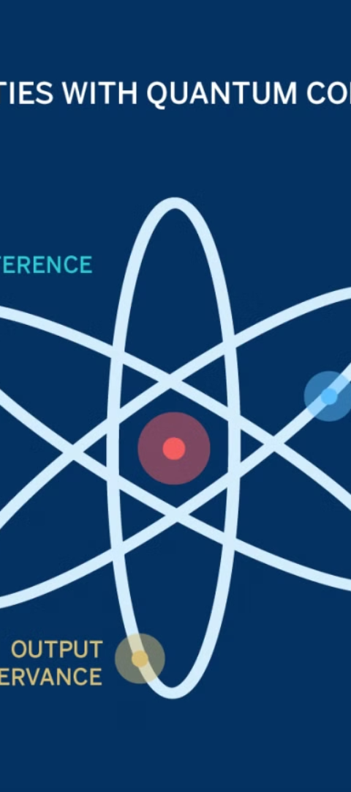
Challenges and Limitations
1
Fragile Qubits
2
Error Correction
Qubits are extremely delicate and susceptible to environmental noise and interference, making them challenging to maintain in a stable state for extended periods.
Developing effective error correction and fault-tolerance techniques is crucial to ensure the reliability and accuracy of quantum computations.
3
Scalability
Scaling up quantum computers to handle larger and more complex problems is a significant engineering challenge that researchers are actively working to overcome.

Slide 19
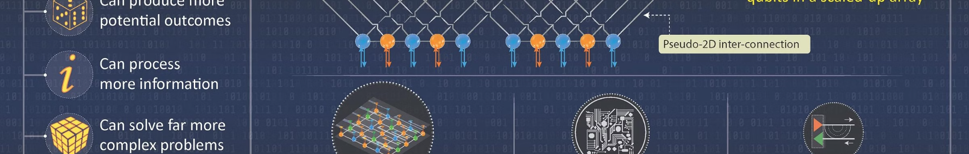



The Future of Quantum Computing
Commercialization
Quantum Internet
Quantum Supremacy
As the technology matures, quantum computers are expected to become more accessible and affordable, leading to their widespread adoption across various industries.
The development of a quantum internet, which can transmit information using quantum mechanics, will enable secure communication and distributed quantum computing.
Achieving "quantum supremacy," where quantum computers outperform classical computers on specific tasks, will be a significant milestone in the field, paving the way for even more advanced applications.

Slide 20

Conclusion: Embracing the Quantum Revolution
Quantum computing represents a transformative shift in the world of technology, promising to unlock unprecedented computational power and unlock solutions to some of the most complex challenges facing humanity. By embracing this quantum revolution, we can expect to witness groundbreaking advancements in fields ranging from science and medicine to finance and cybersecurity, shaping the future of our world.

